Slide 1
ThedyxEngine
2D Thermodynamics Simulator
Rostyslav Liapkin

Slide 2
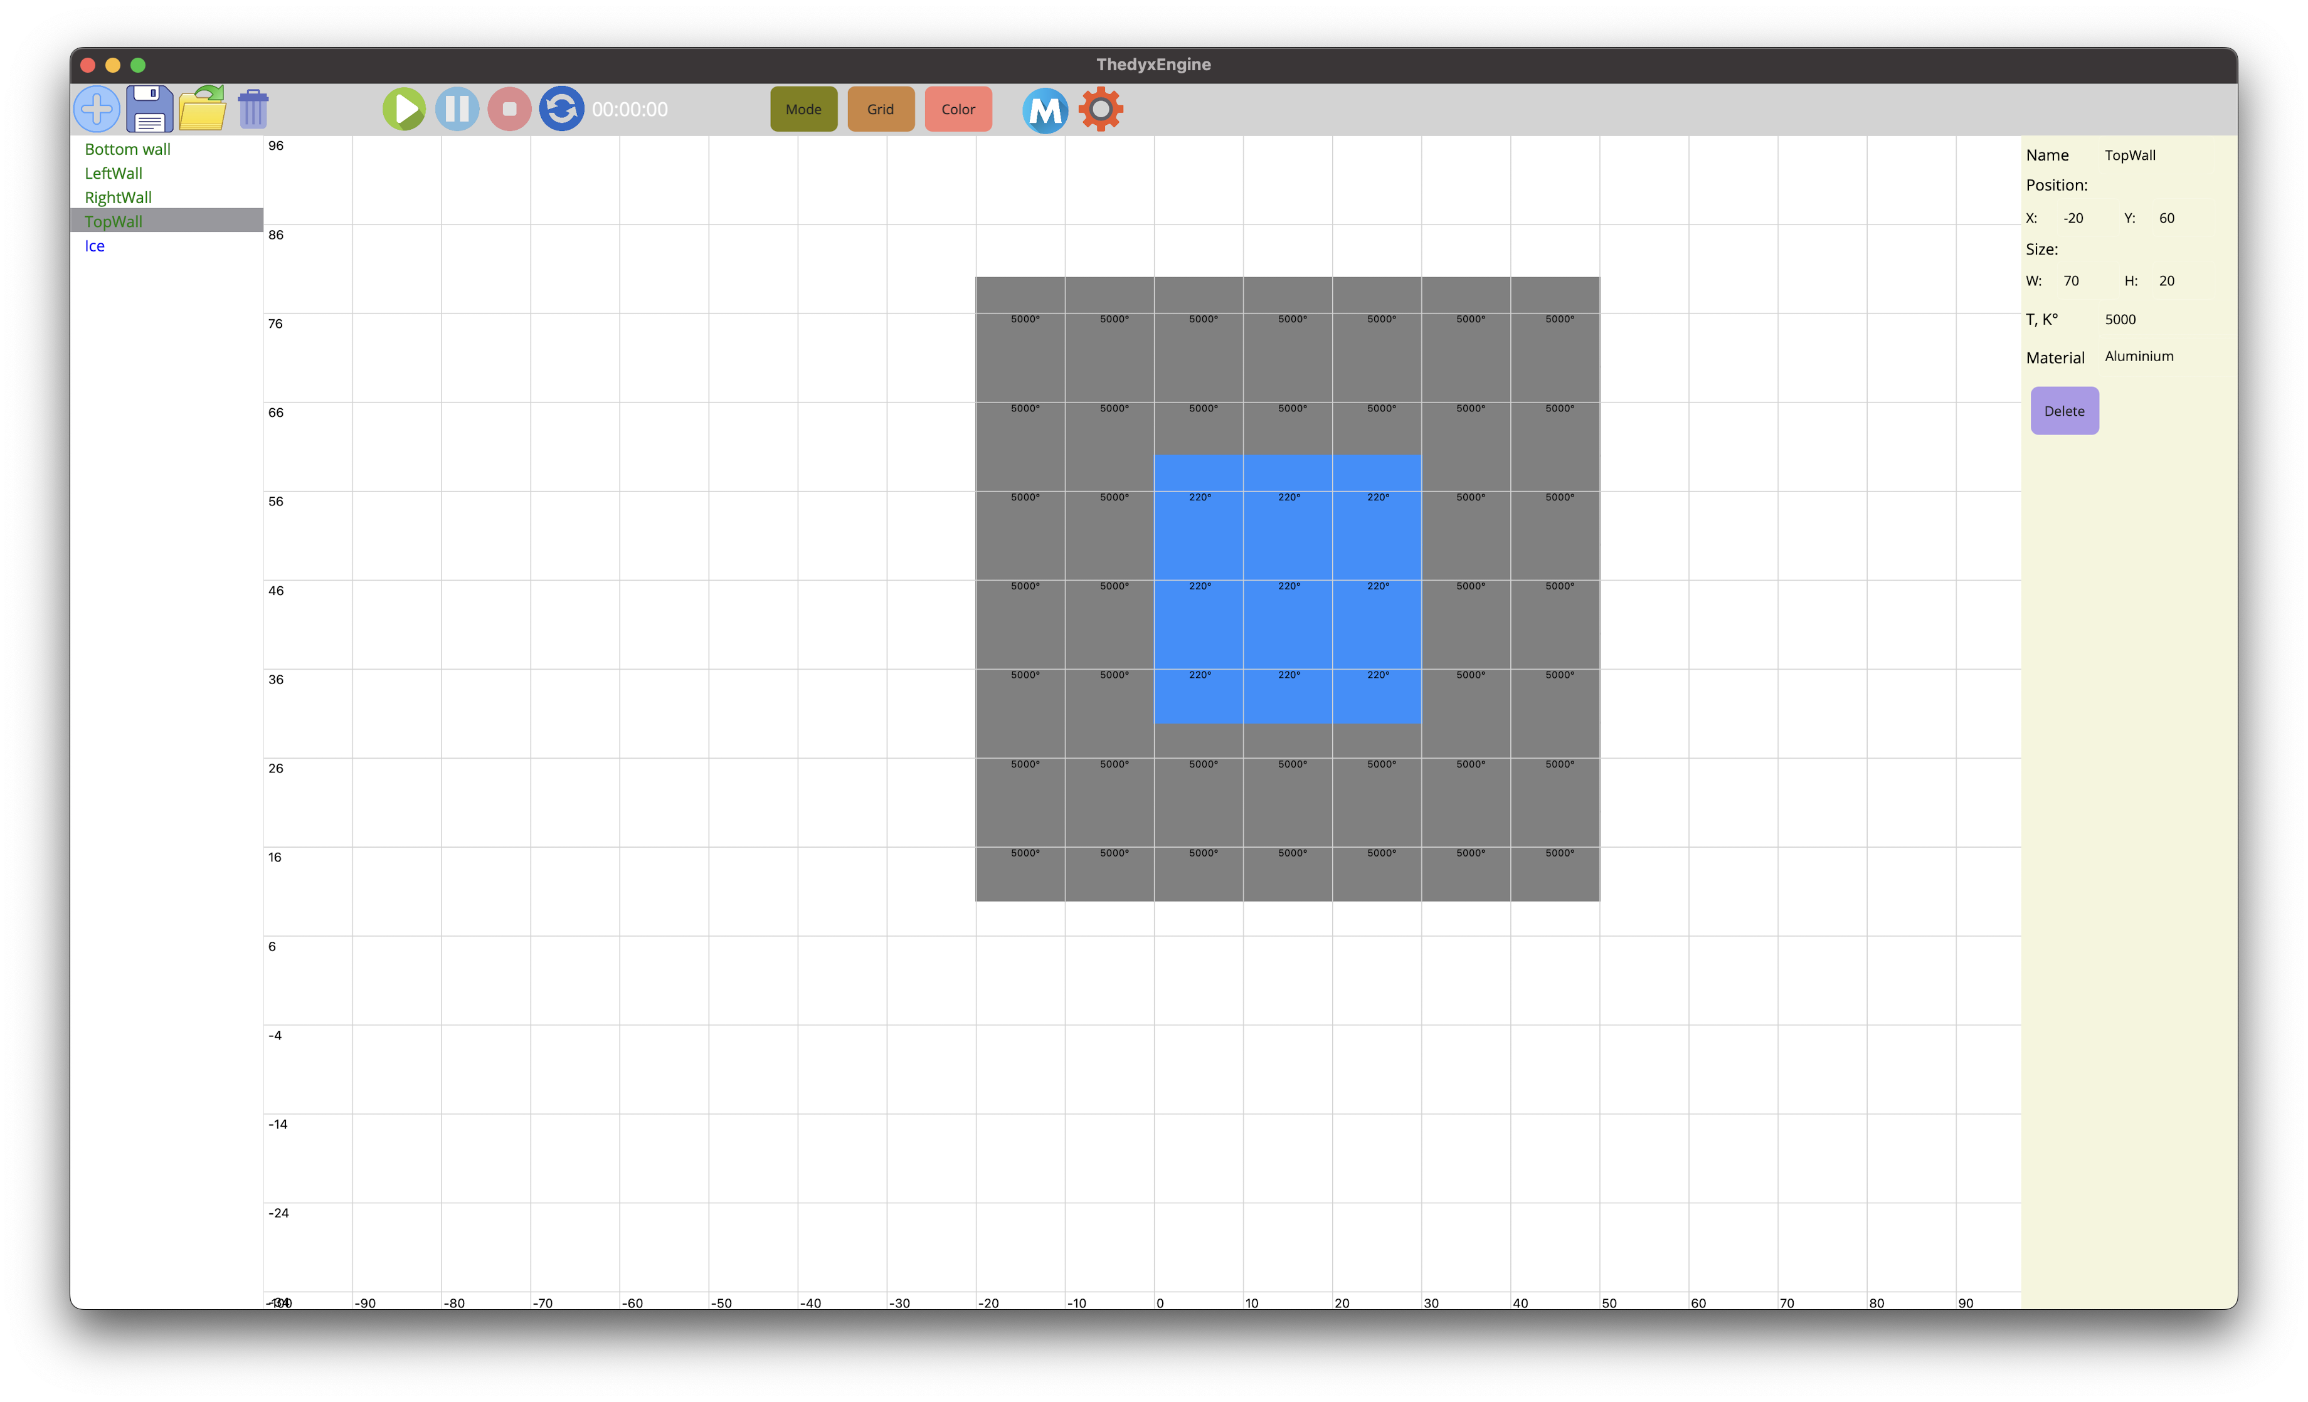
Introduction
ThedyxEngine is a 2D physics engine designed to simulate heat transfer across different materials using a visually intuitive approach.

Slide 3
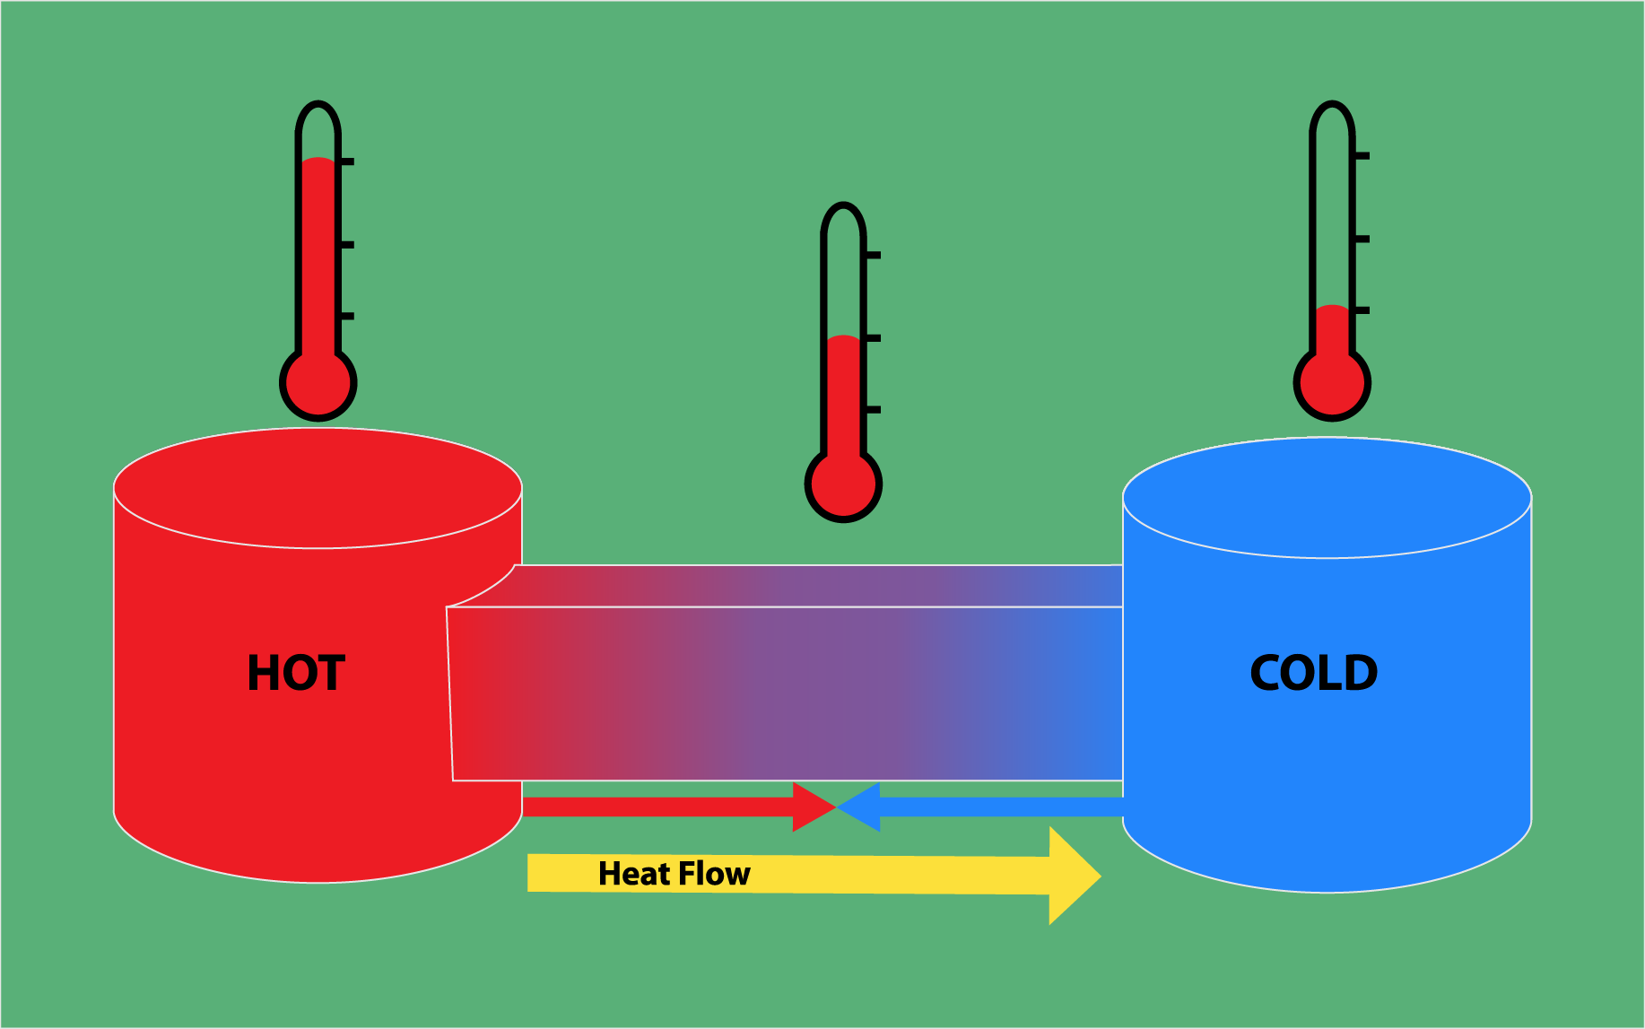
Motivation
Bridging Theory and Practice: Traditional thermodynamics and heat transfer studies are often abstract and theoretical.
User-Friendly Simulation: Existing simulation tools can be too complex for the average user to operate effectively.

Slide 4
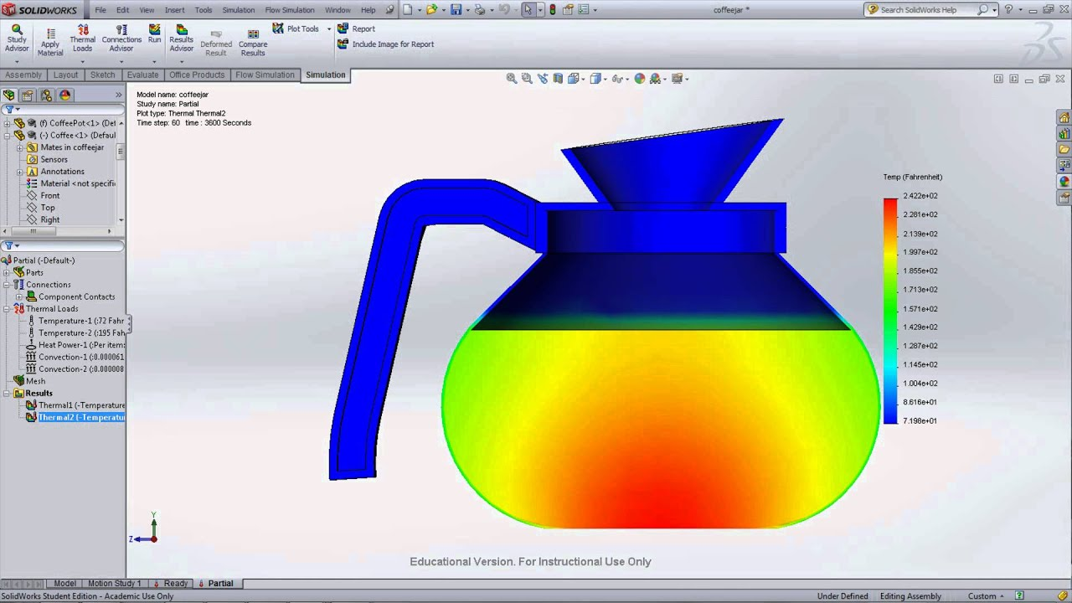
Motivation
Accessible Education: ThedyxEngine serves as a free, intuitive platform that makes thermodynamics accessible for learning and experimentation.
Open-Source Innovation: As an open-source project, it invites collaboration and continuous improvement from the community.

Slide 5
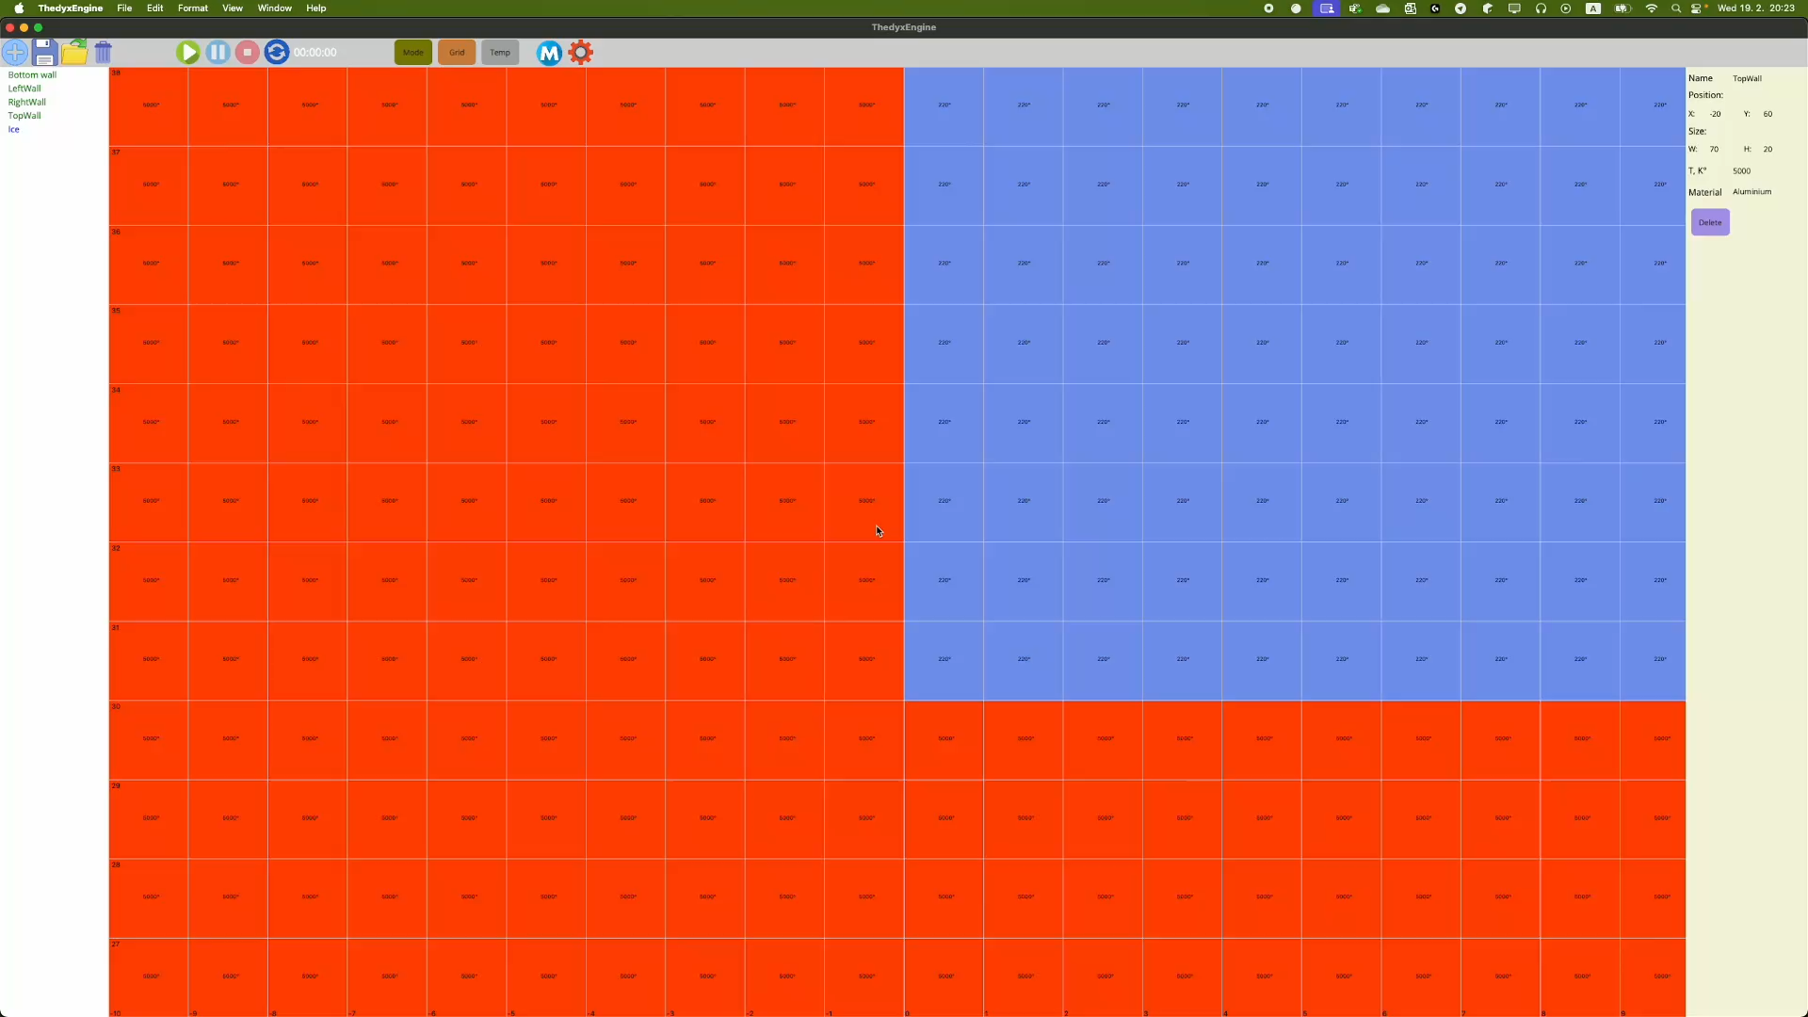
Novelty
Low System Requirements: Optimized to run on modest hardware on different platforms.
Community-Maintained & Open Source: Built with a popular framework and language, available to everyone.
High Precision: Granular simulation for accurate heat transfer modeling.

Slide 6

Technologies
.NET 9.0 (compatible with .NET 8.0)
MAUI (Multi-platform App UI)
MAUI Community Toolkit

Slide 7
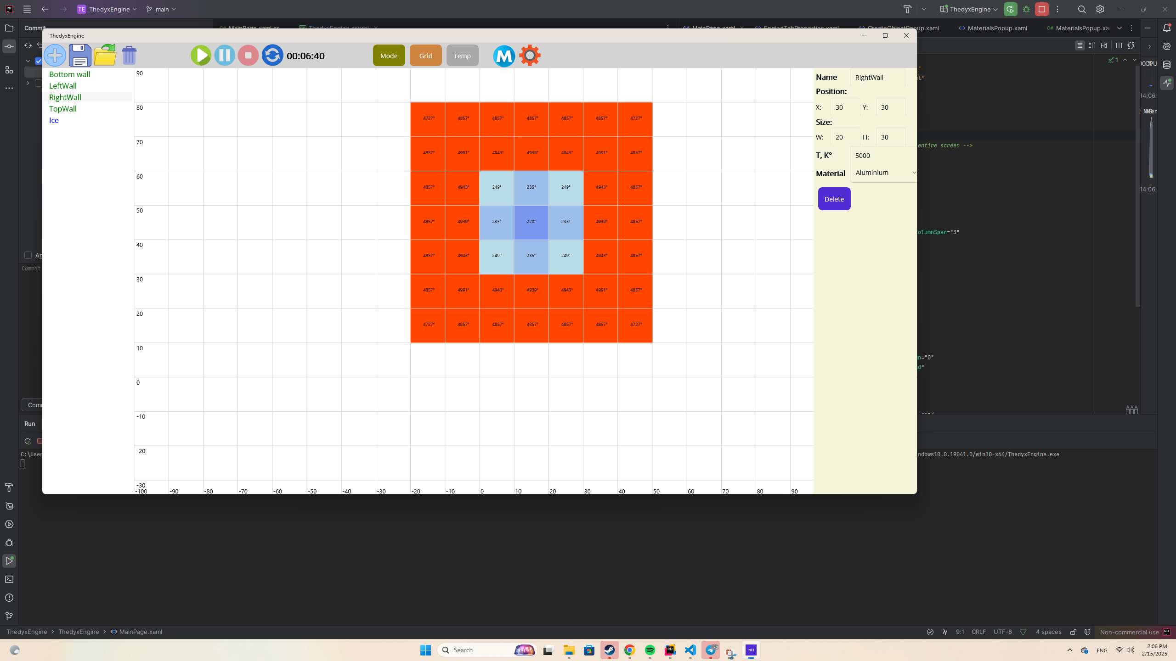
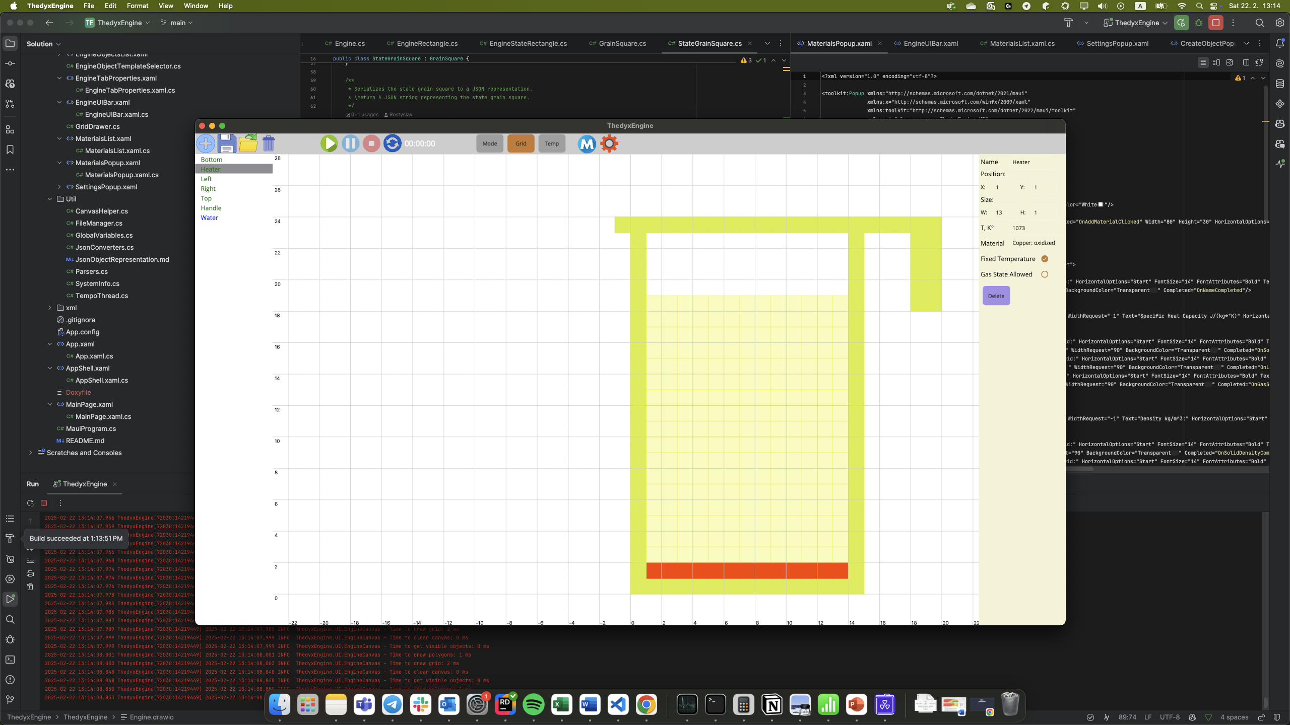
Cross Platform
MacOS (Main Platform)
Windows

Slide 8
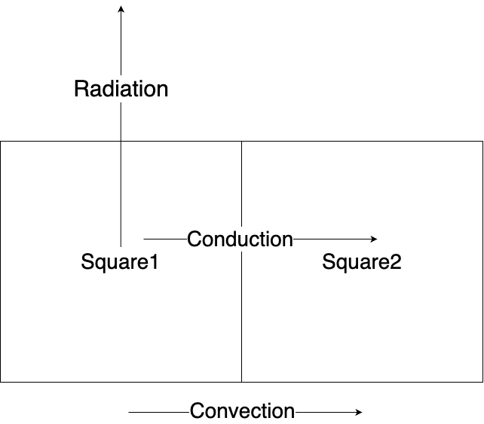
Methodology
Grid-Based Decomposition: Each object is divided into a grid of small squares.
Discrete Energy Transfer: Energy is transferred between grain squares, allowing for localized temperature calculation.
Time-Stepped Simulation: Simulation is made in discrete time steps, calculating the amount of energy transferred in each interval.

Slide 9
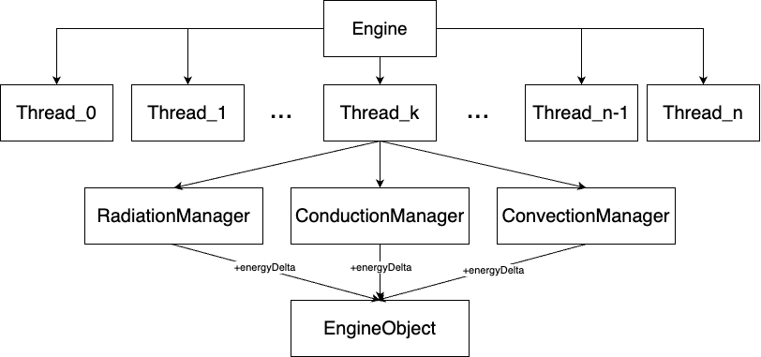
Engine
Threads: Each thread makes calculations for its own group of objects
Managers: Managers to transfer energy by radiation, conduction and convection
EngineObject: EngineObject changes its temperature after all energy changes are calculated.

Slide 10
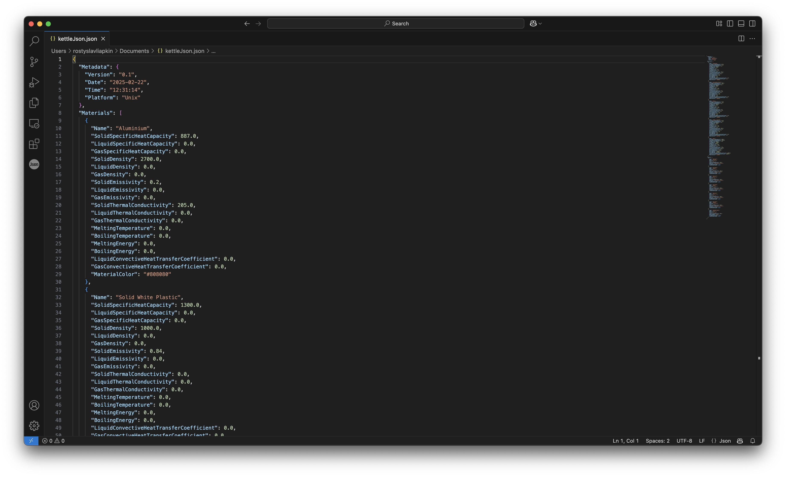
File Format
Custom .tdx file format
Saves the whole environment
Can be saved as a human readable Json
Can be saved as a Base64 string

Slide 11
Benchmarking: Multicore efficiency
TimeSteps in one minute, scene with objects 10*10, without rendering, only engine
Apple M3 Pro (6 performance, 6 efficiency cores). Tested 5 times

Slide 12
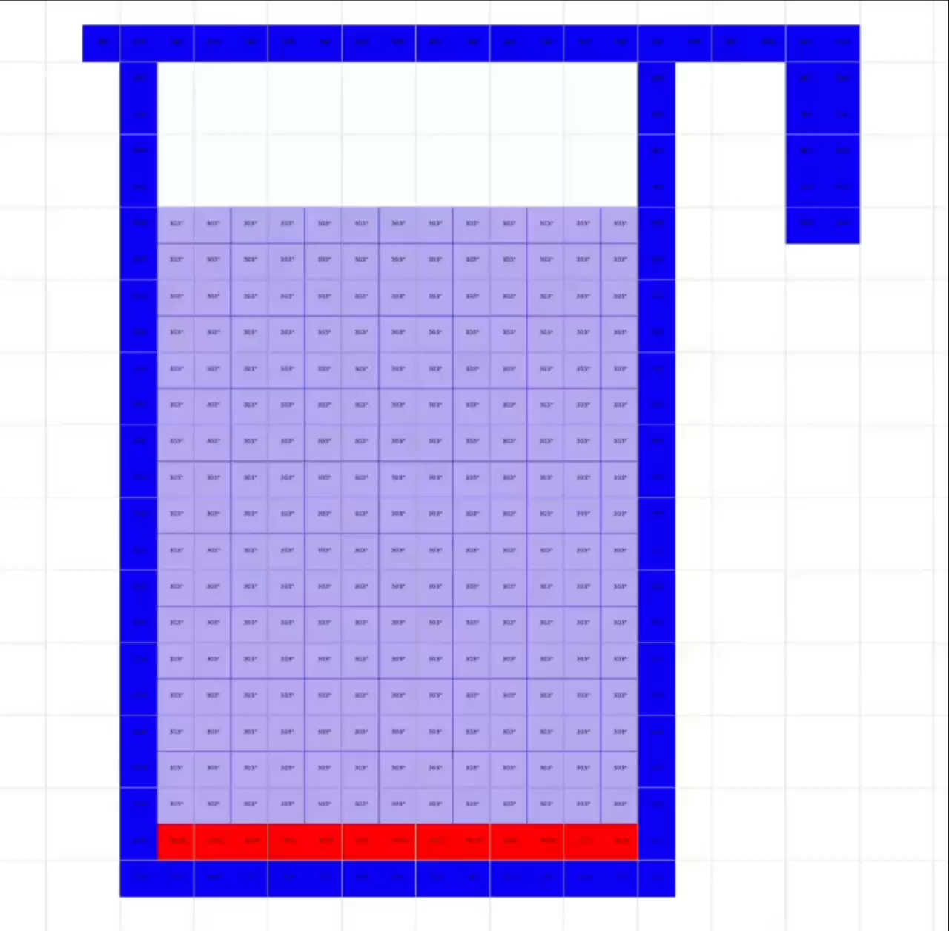
Precision testing
Comparing with my real kettle Heating water from 30°C to 90°C

Slide 13
Precision testing
Results are good enough
Difference can be explained by changes in the coefficients

Slide 14
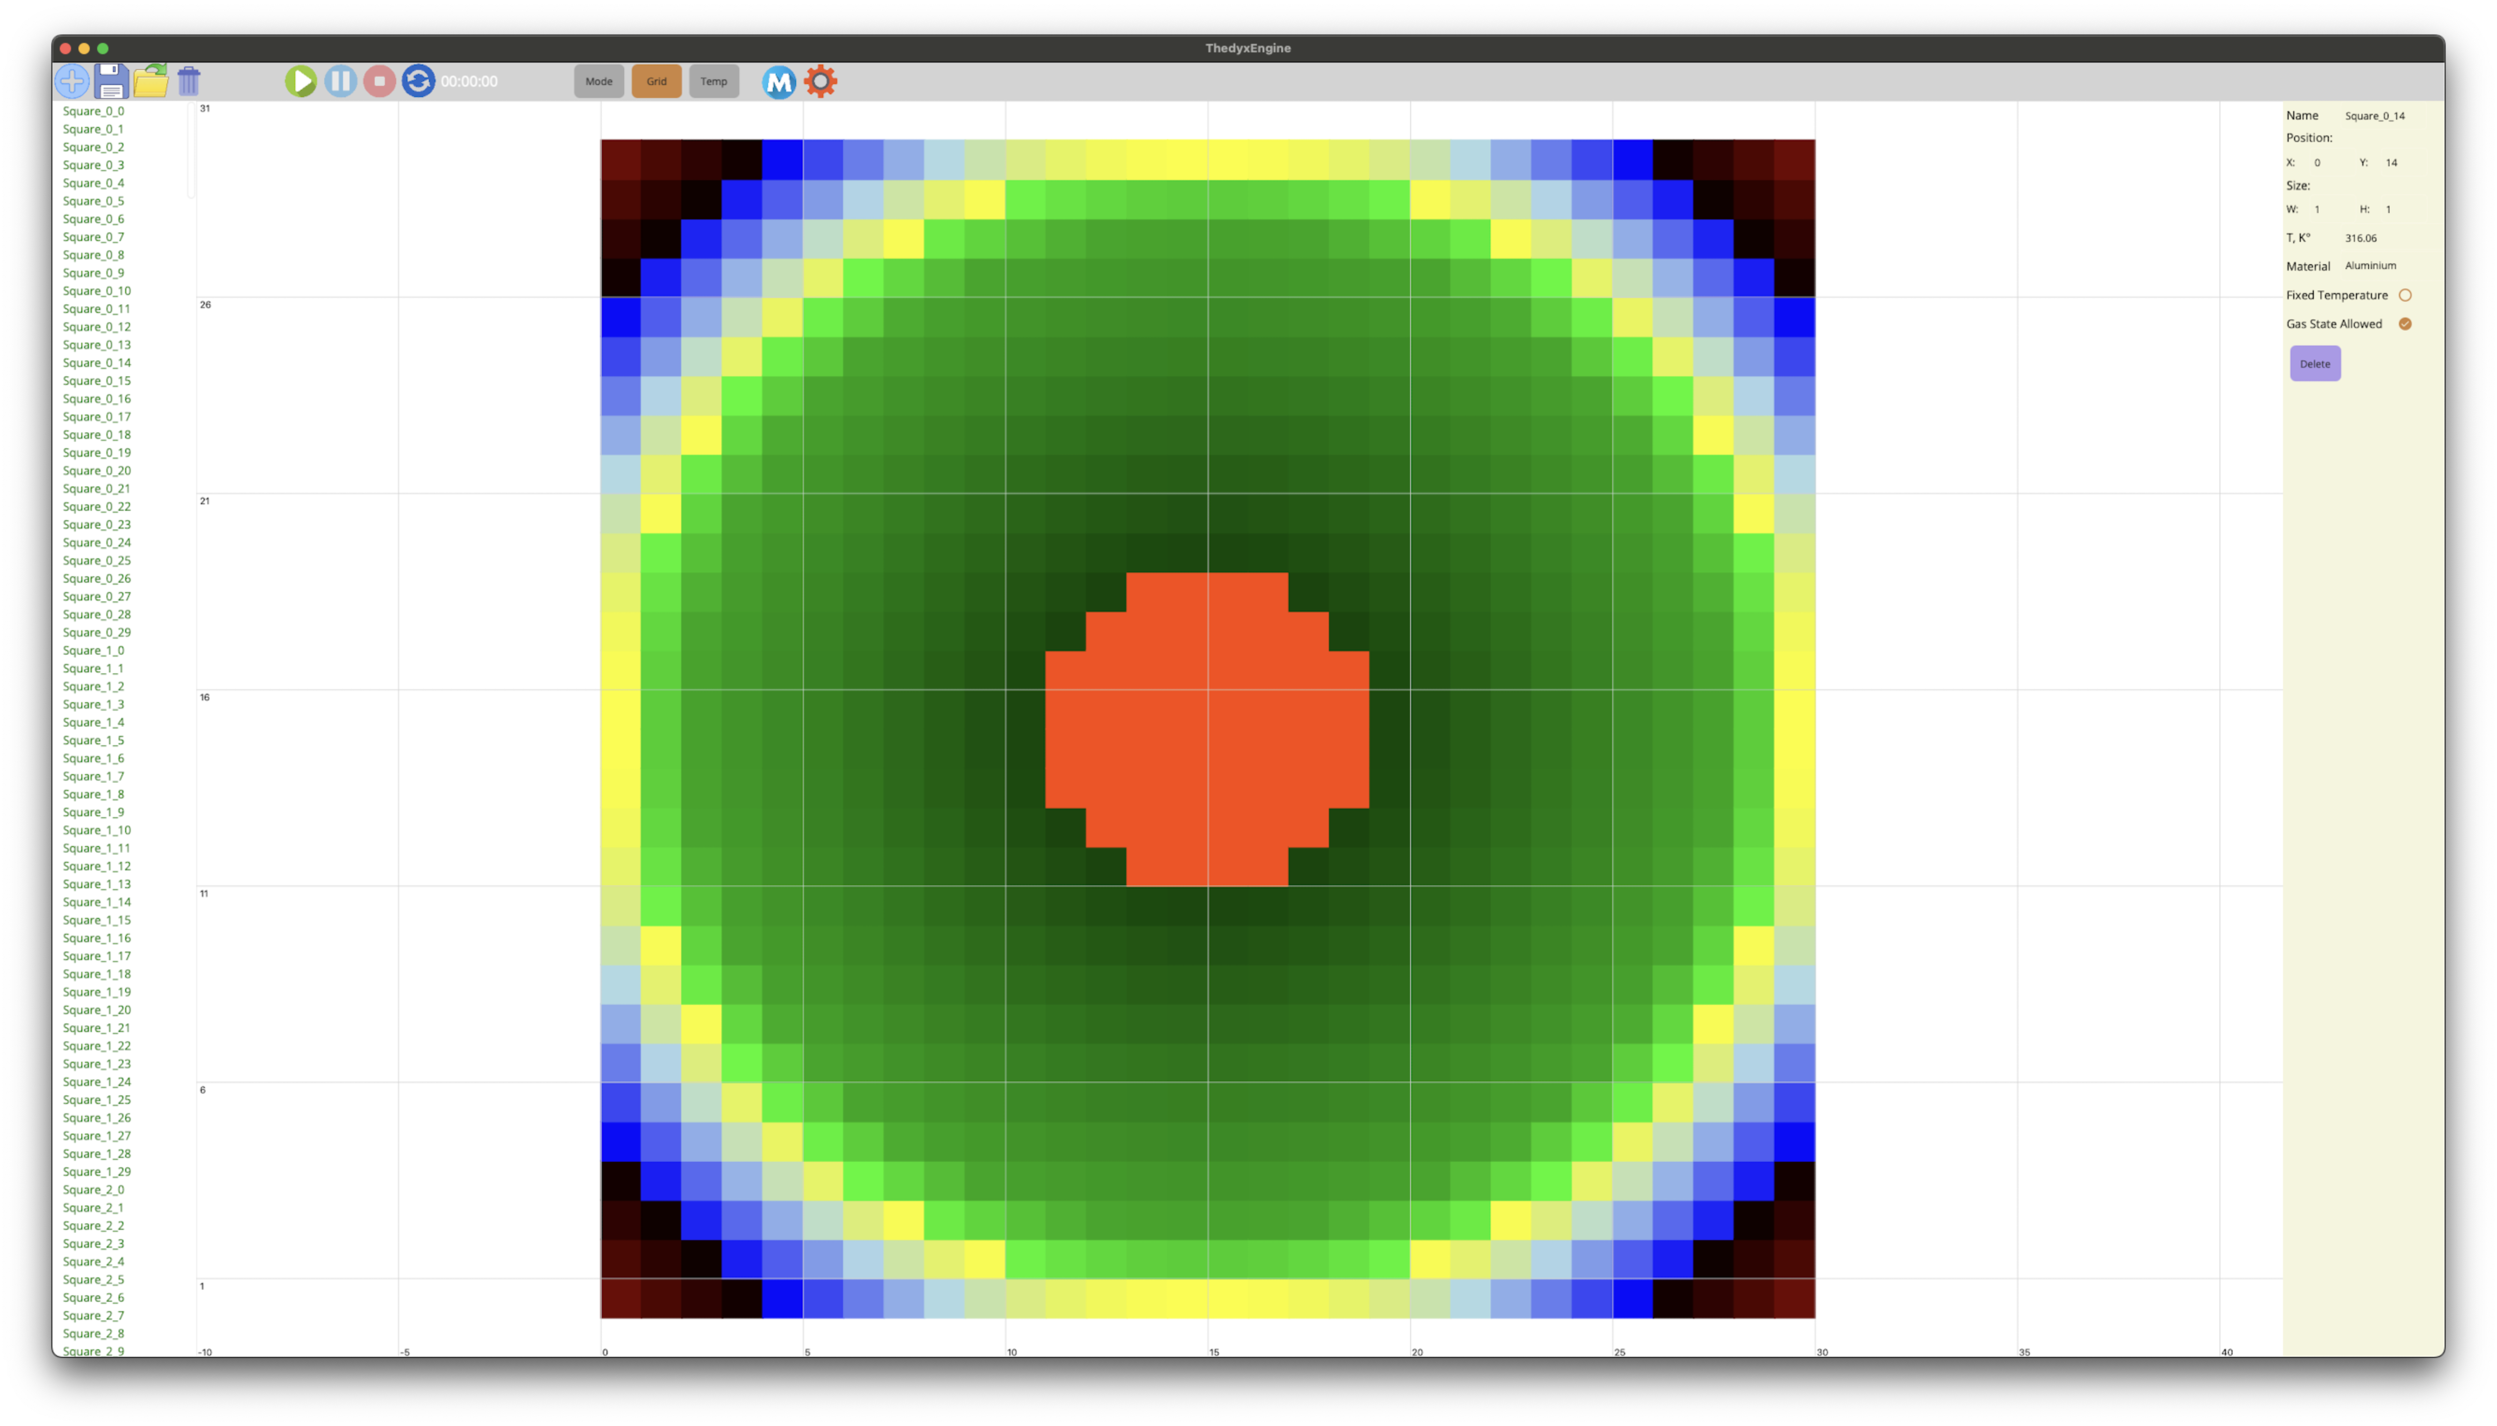
Limitations
MAUI render engine performance limitations
Not perfect with big temperature difference
Discrete simulations are not perfect at precision
Impossible to simulate objects that are smaller than 1 mm

Slide 15
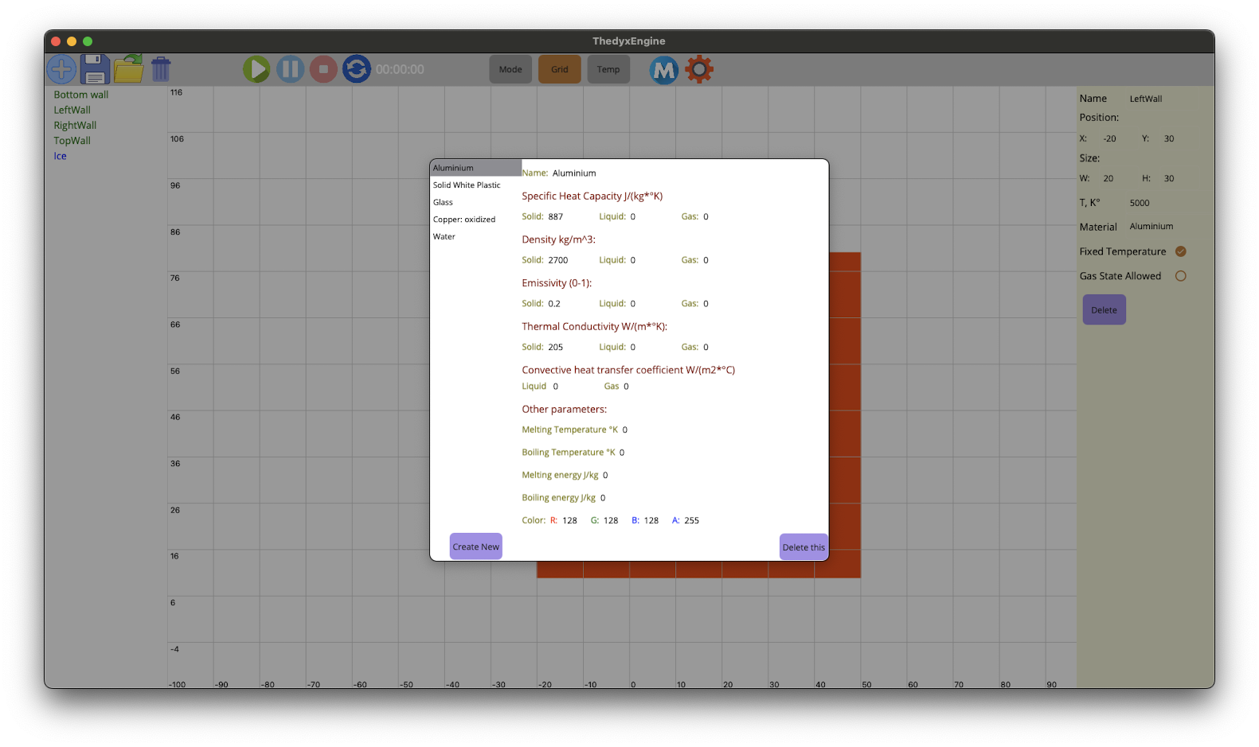
Future directions
Dynamic coefficients for all materials
Better UI/UX
Saving data about all objects during the simulation
Non-static objects
UI performance impovements
Comparison with real data

Slide 16

More examples
Copper pipe
Heated in one place with an 800°C heater
Just looks good

Slide 17

Q&A

Slide 18
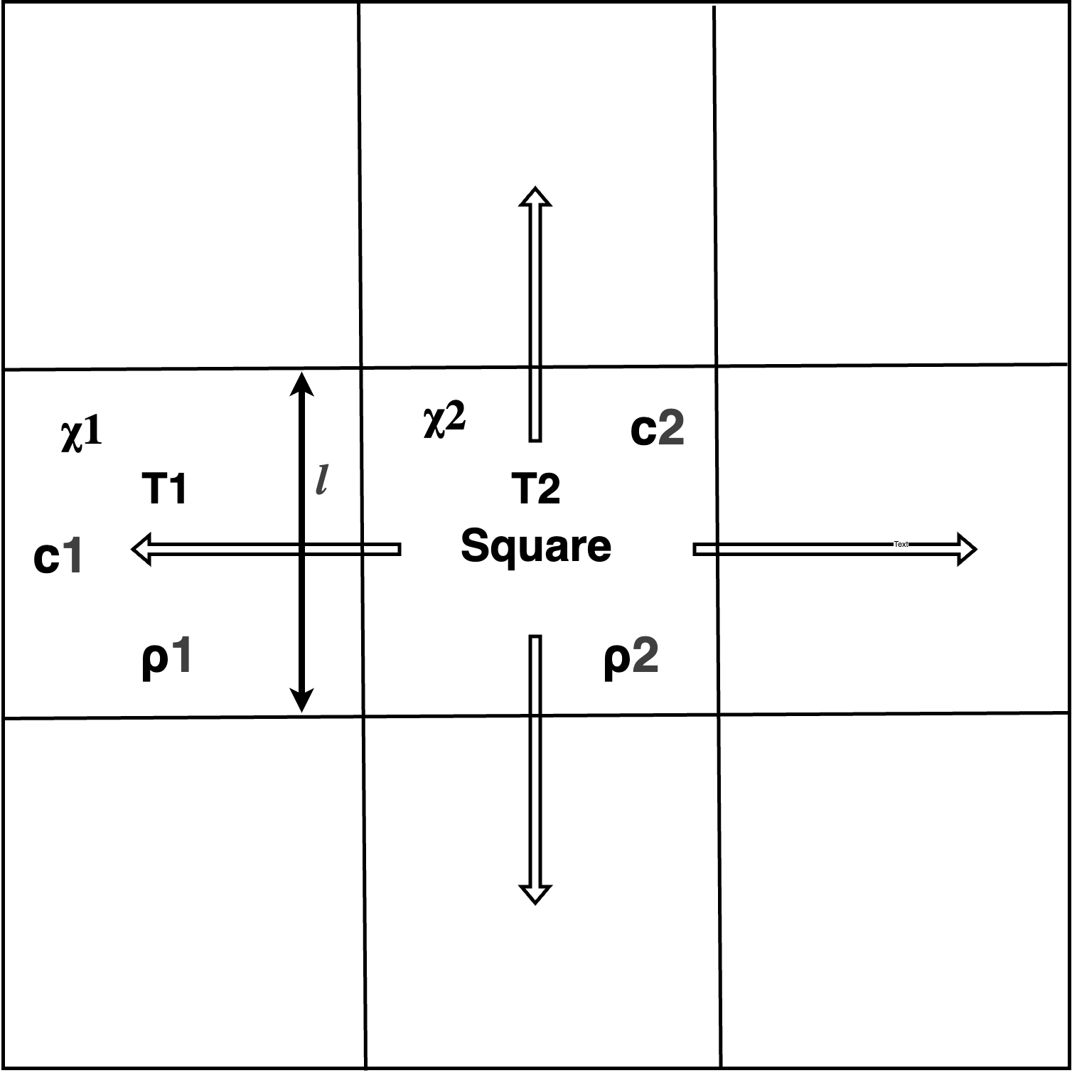
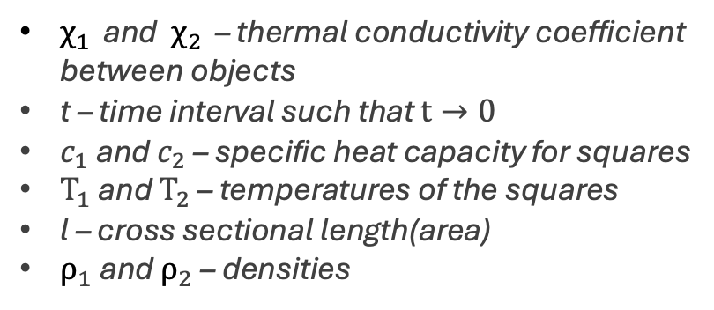

Conduction transfer
Fourier law of a heat conduction
$∆T_{1}=\frac{− χ ×\left(T_{1}−T_{2}\right) ×t ×h}{c_{1}×ρ_{1}× l^{2} ×h}$
$∆T_{2}= \frac{Q}{c_{2}×m_{2}}=−\frac{P ×t}{c_{2}×m_{2}}= \frac{χ ×\left(T_{1}−T_{2}\right) ×t }{c_{2}×ρ_{2}× l^{2} }$
$χ$ = $\frac{χ_{1 }×{ χ}_{2 }}{χ_{1 }+ χ_{2 }}$
$χ_{1 }$ and ${ χ}_{2 }$ – thermal conductivity coefficient between objects
t – time interval such that $t→0$
$c_{1}$ and $c_{2}$ – specific heat capacity for squares
$T_{1}$ and $T_{2}$ – temperatures of the squares
l – cross sectional length(area)
$ρ_{1}$ and $ρ_{2}$ – densities

Slide 19
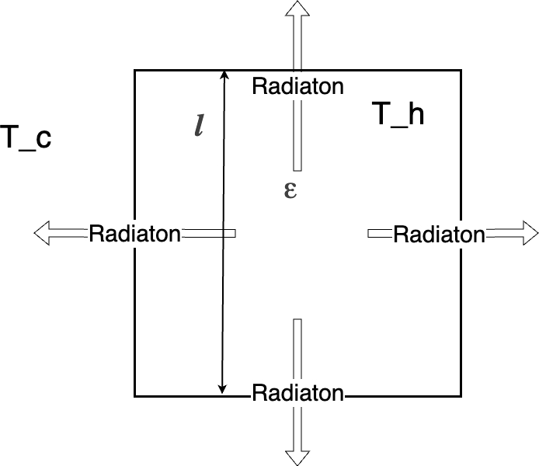
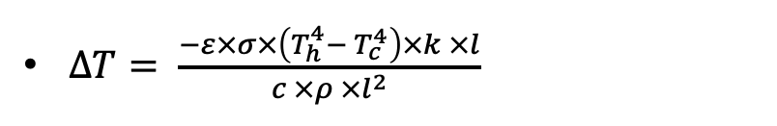
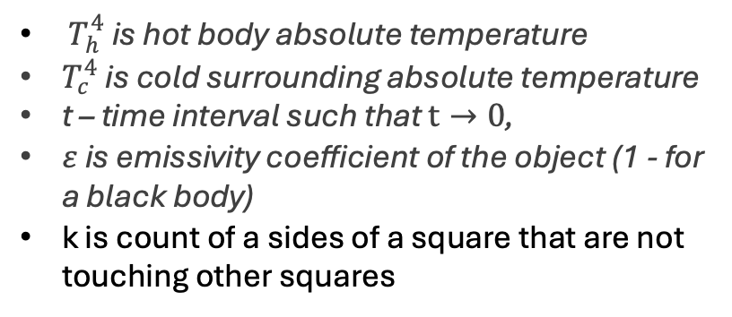
Radiation transfer with air
Stefan-Boltzmann Law
$∆T= \frac{−ε×σ×\left(T_{h}^{4}− T_{c}^{4}\right)×k ×l}{c ×ρ ×l^{2}}$
$T_{h}^{4}$ is hot body absolute temperature
$T_{c}^{4}$ is cold surrounding absolute temperature
t – time interval such that $t→0$,
$ε$ is emissivity coefficient of the object (1 - for a black body)
k is count of a sides of a square that are not touching other squares

Slide 20
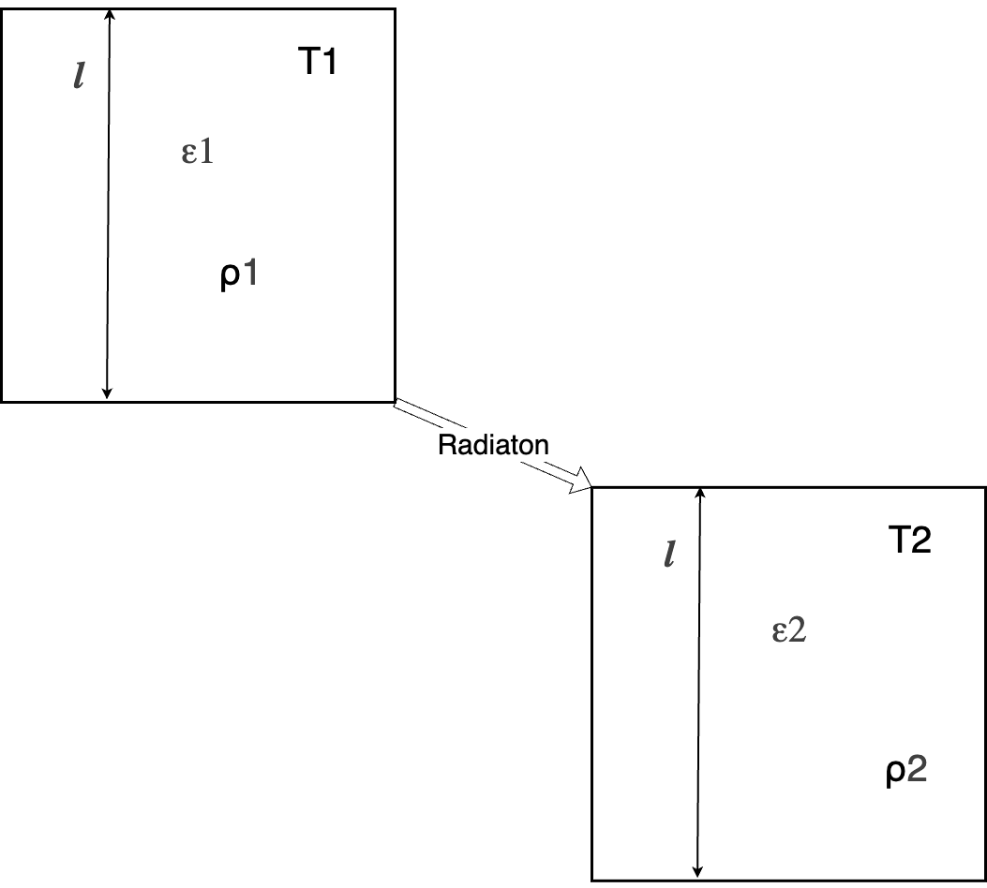
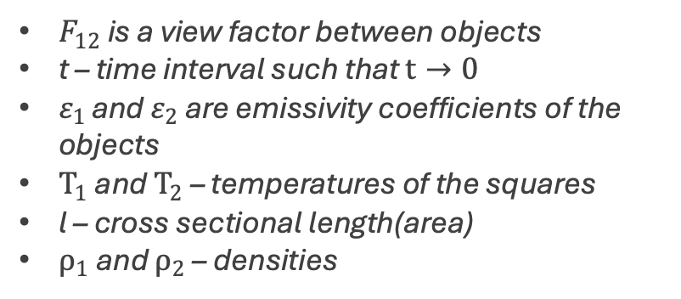
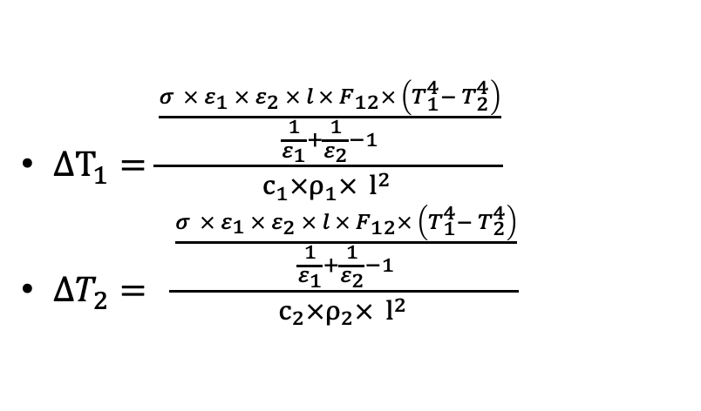
Radiation Transfer Between Objects
Derivative Kirchhoff's law of thermal radiation
$∆T_{1}=\frac{\frac{σ × ε_{1 }× ε_{2} × l × F_{12}× \left(T_{1}^{4}− T_{2}^{4}\right)}{\frac{1}{ε_{1}}+\frac{1}{ε_{2}}−1}}{c_{1}×ρ_{1}× l^{2} }$
$∆T_{2}= \frac{\frac{σ × ε_{1 }× ε_{2} × l × F_{12}× \left(T_{1}^{4}− T_{2}^{4}\right)}{\frac{1}{ε_{1}}+\frac{1}{ε_{2}}−1}}{c_{2}×ρ_{2}× l^{2} }$
$F_{12}$ is a view factor between objects
t – time interval such that $t→0$
$ε_{1 }$and $ε_{2}$ are emissivity coefficients of the objects
$T_{1}$ and $T_{2}$ – temperatures of the squares
l – cross sectional length(area)
$ρ_{1}$ and $ρ_{2}$ – densities

Slide 21
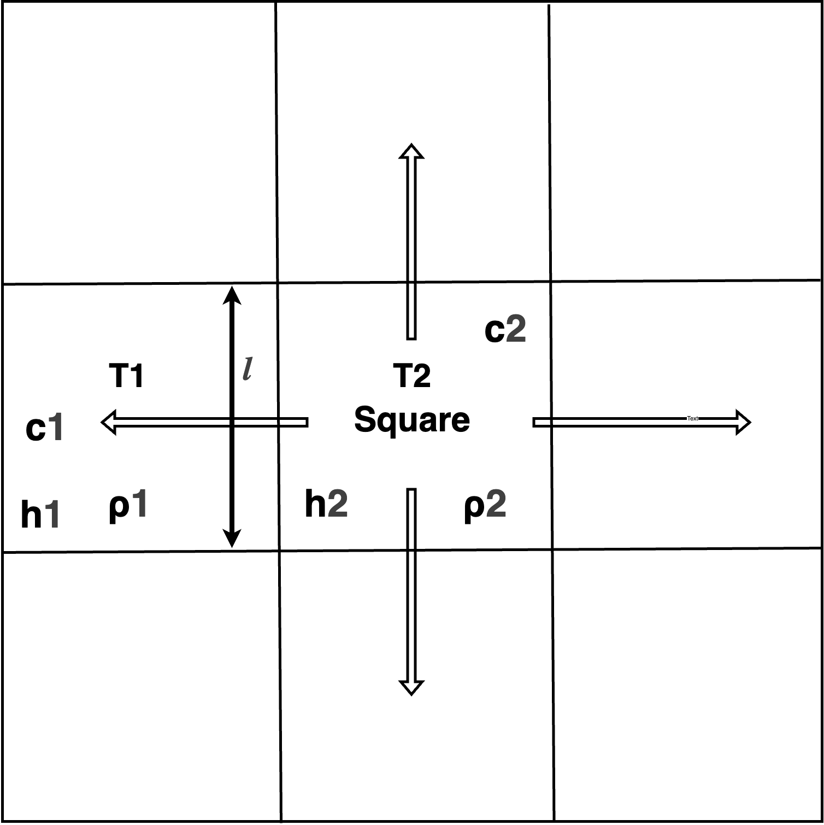
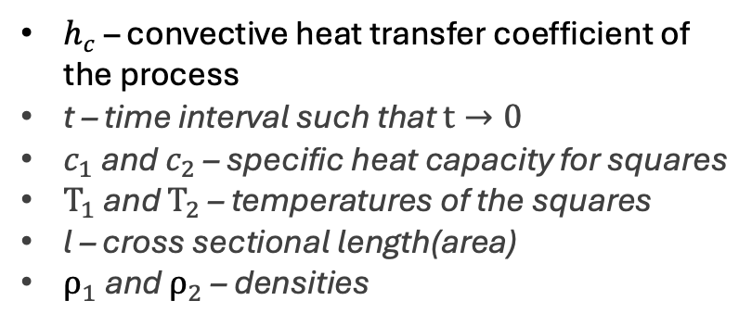
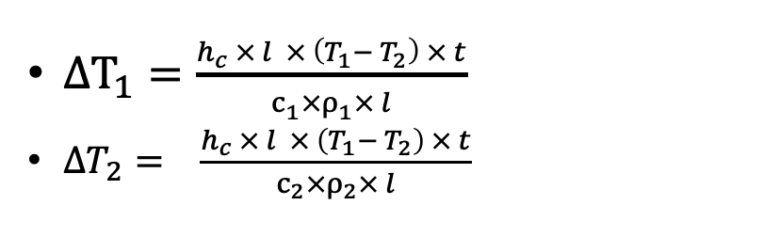
Convection transfer
Newton's Law of Cooling
$∆T_{1}=\frac{h_{c} × l × \left(T_{1}− T_{2}\right) × t}{c_{1}×ρ_{1}× l}$
$∆T_{2}= \frac{h_{c} × l × \left(T_{1}− T_{2}\right) × t}{c_{2}×ρ_{2}× l}$
$h_{c}$ – convective heat transfer coefficient of the process
t – time interval such that $t→0$
$c_{1}$ and $c_{2}$ – specific heat capacity for squares
$T_{1}$ and $T_{2}$ – temperatures of the squares
l – cross sectional length(area)
$ρ_{1}$ and $ρ_{2}$ – densities

